Slide 1



ROD CUTTING PROBLEM
EXPLANATION
The rod cutting problem is a classic optimization problem where we need to determine the maximum possible value that can be obtained by cutting a rod into smaller pieces and selling them. Each piece of the rod has a certain value associated with it. The goal is to find the optimal cuts to maximize the total value.
The Recursive (Top-Down) Approach with Memoization for Rod Cutting involves defining a recursive function that explores all possible cut combinations.
Memoization is employed to store and reuse previously computed results, avoiding redundant calculations.

Slide 2
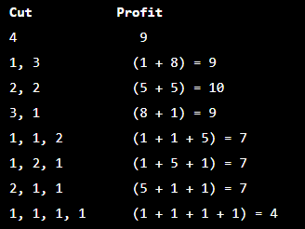
ROD CUTTING PROBLEM
EXAMPLE
Input
price[] = [1, 5, 8, 9]
Rod length: 4
Output
10
Explanation
Cut the rod into two pieces of length 2 each to gain revenue of 5 + 5 = 10

Slide 3
APPROACHES
The time complexity is O(n^2)
The space complexity is O(n)
The Dynamic Programming approach is commonly used to solve the rod cutting problem. We create an auxiliary array, `val[]`, where `val[i]` represents the maximum obtainable value for a rod of length `i`.
The Recursive (Top-Down) Approach with Memoization for Rod Cutting involves defining a recursive function that explores all possible cut combinations. Memoization is employed to store and reuse previously computed results, avoiding redundant calculations.

Slide 4
ROD CUTTING PROBLEM
class Main {
public static int cutRod(int[] price, int n) {
int[] val = new int[n + 1];
val[0] = 0;
for (int i = 1; i <= n; i++) {
int maxVal = Integer.MIN_VALUE;
for (int j = 0; j < i; j++) {
maxVal = Math.max(maxVal, price[j] + val[i - j - 1]);
}
val[i] = maxVal;
}
return val[n];
}
public static void main(String[] args) {
int[] price = {1, 5, 8, 9, 10, 17, 17, 20};
int n = price.length;
int maxVal = cutRod(price, n);
System.out.println("Maximum obtainable value is" + maxVal);
}
}
Notes:
22

Slide 5
INTERVIEW QUESTIONS
4. Can you optimize the Rod Cutting algorithm for better time complexity?
Answer: Yes, an optimized solution using bottomup dynamic programming can achieve O(n^2) time complexity. Additionally, more advanced techniques like matrix exponentiation can further improve the time complexity to O(n log n).

